Slide 1

Tanzu Community Edition - 201

Slide 2
TCE is a Kubernetes Platform
Kubernetes = a platform for building platforms
TCE = a k8s native DevEx Platform

Slide 3
TCE is comprised of
Kubernetes
Tooling
Services
Packaging
DevEx!
Cloud Provider Integrations
Docker
AWS
Azure
vSphere

Slide 4
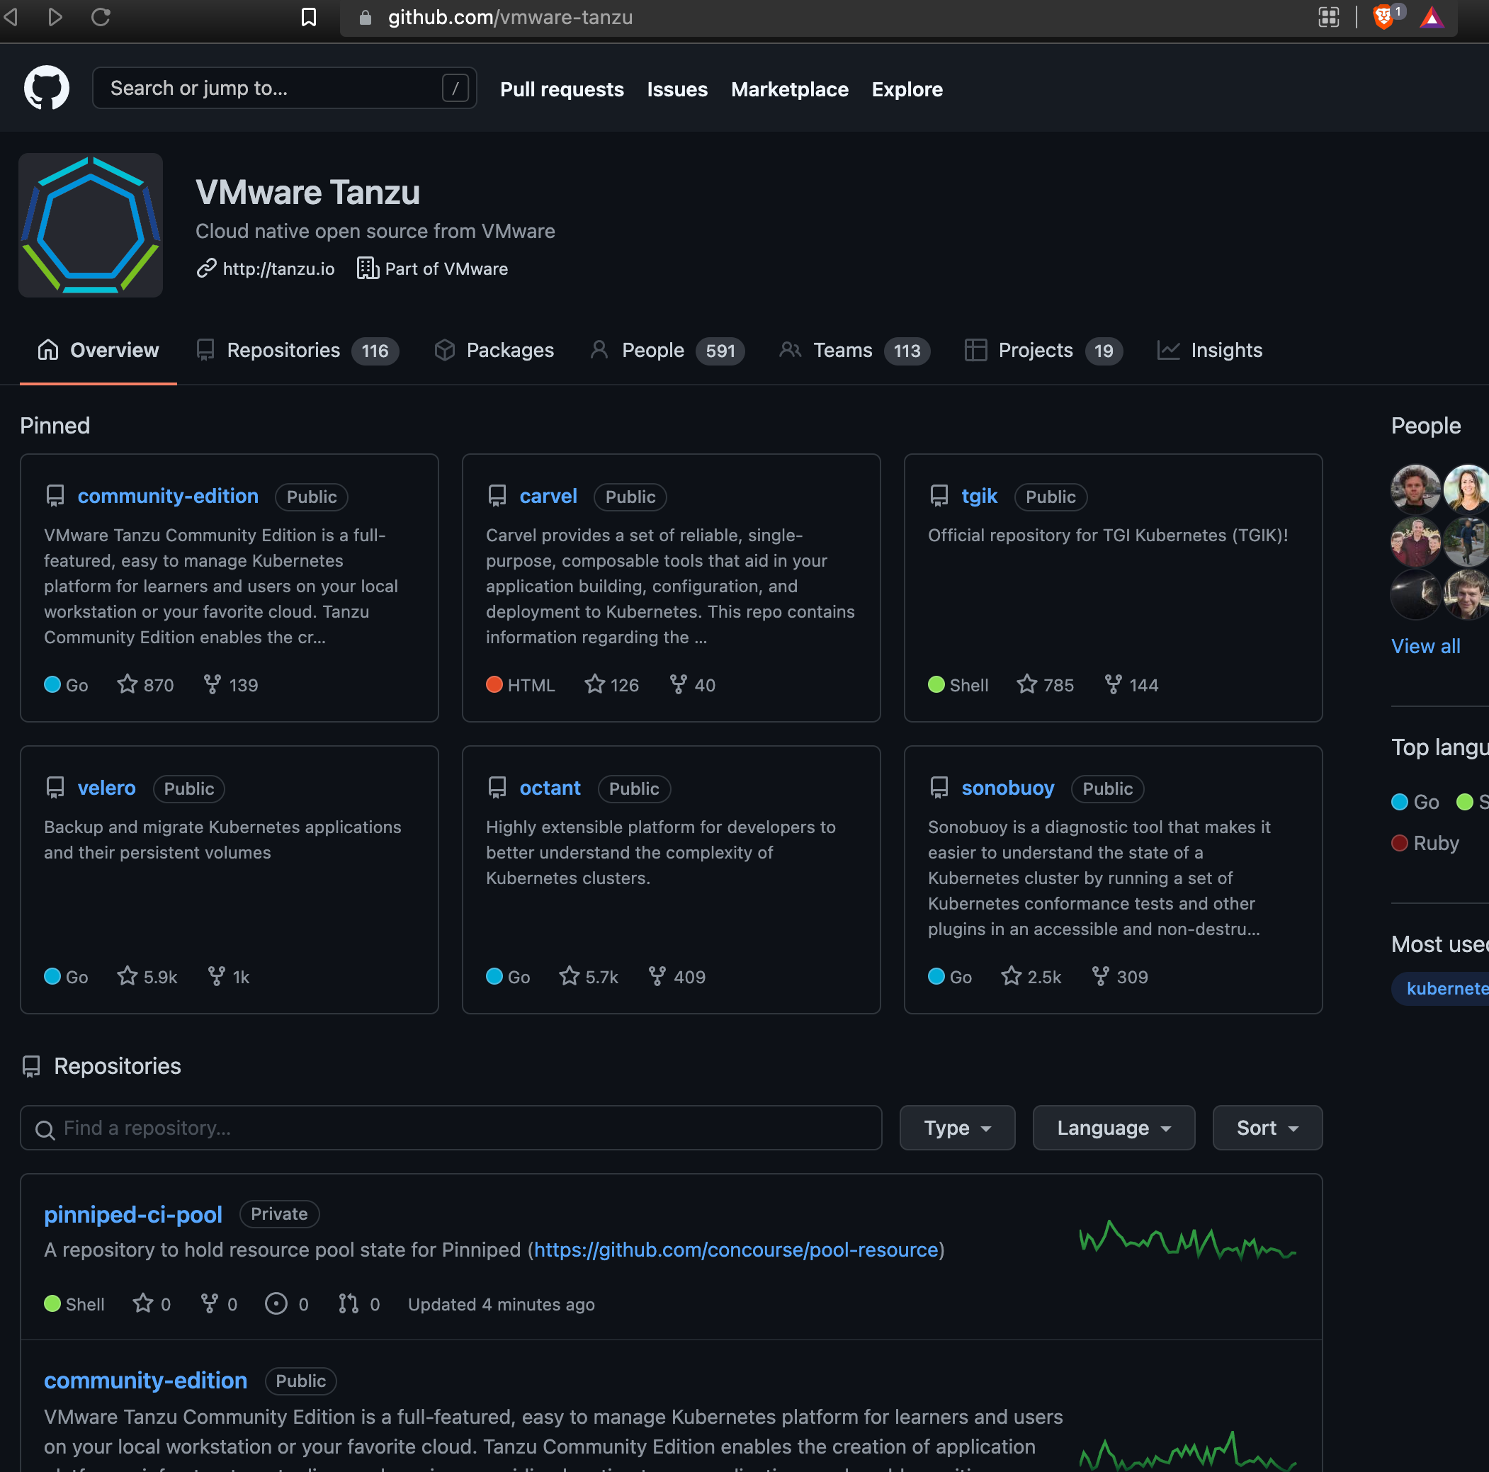
TCE is distribution of VMware Tanzu that is…
Open Source
github.com/vmware-tanzu →

Slide 5
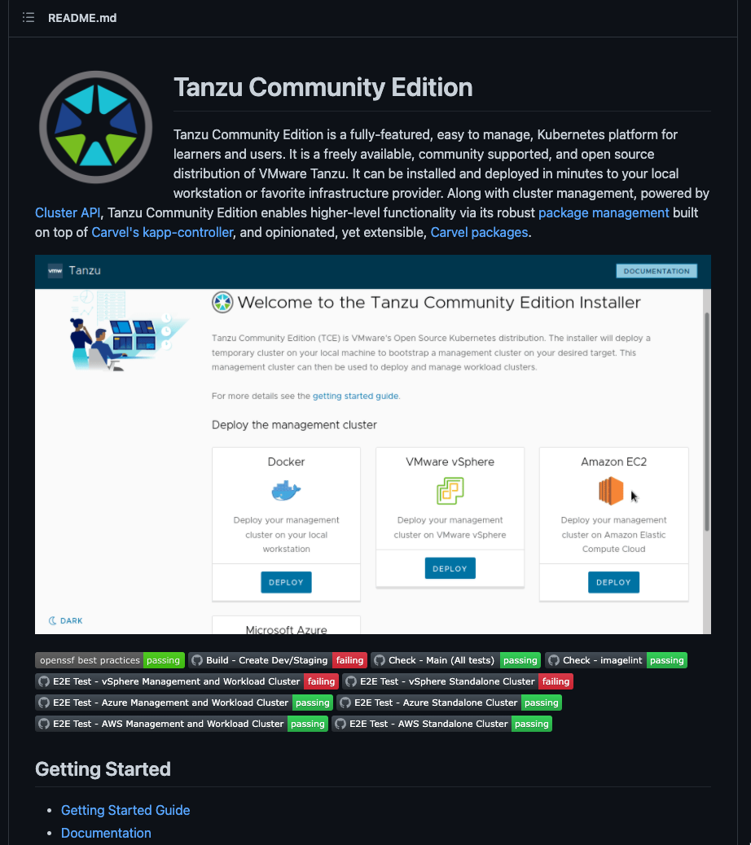
TCE is distribution of VMware Tanzu that is…
Open Source
github.com/vmware-tanzu/community-edition →
Freely Available
Community Supported

Slide 6
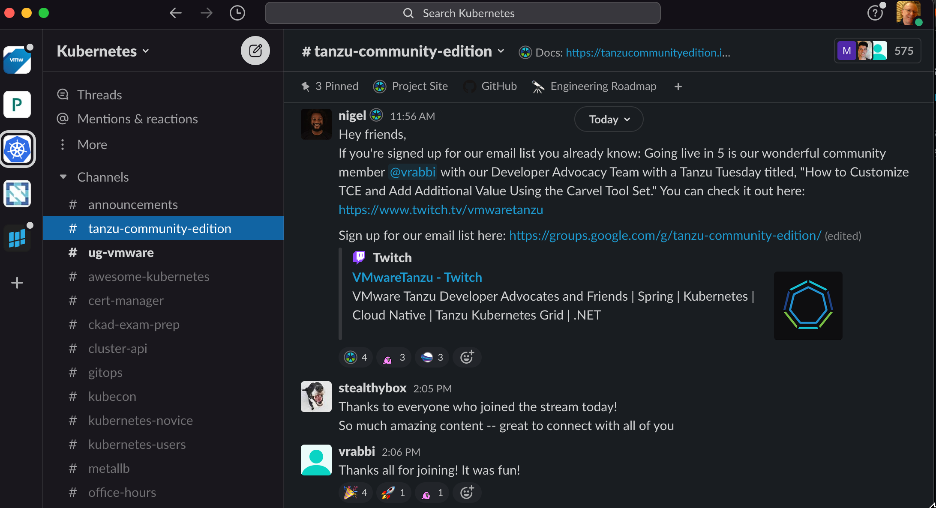
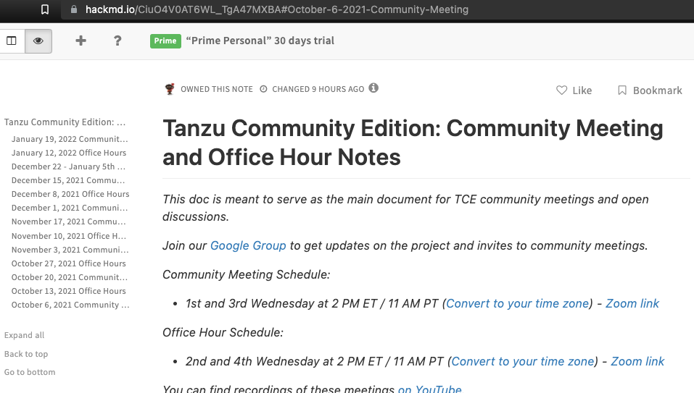
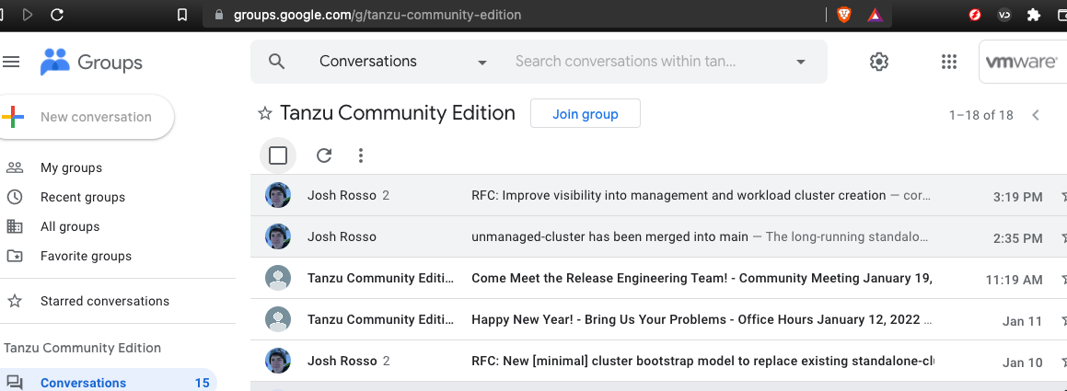
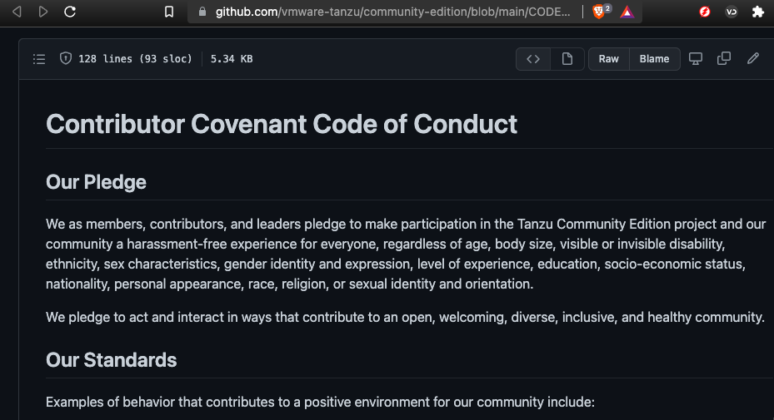
TCE is welcoming community
CNCF slack channel
Weekly community meetings
Google Group
Contributor Covenant Code of Conduct

Slide 7
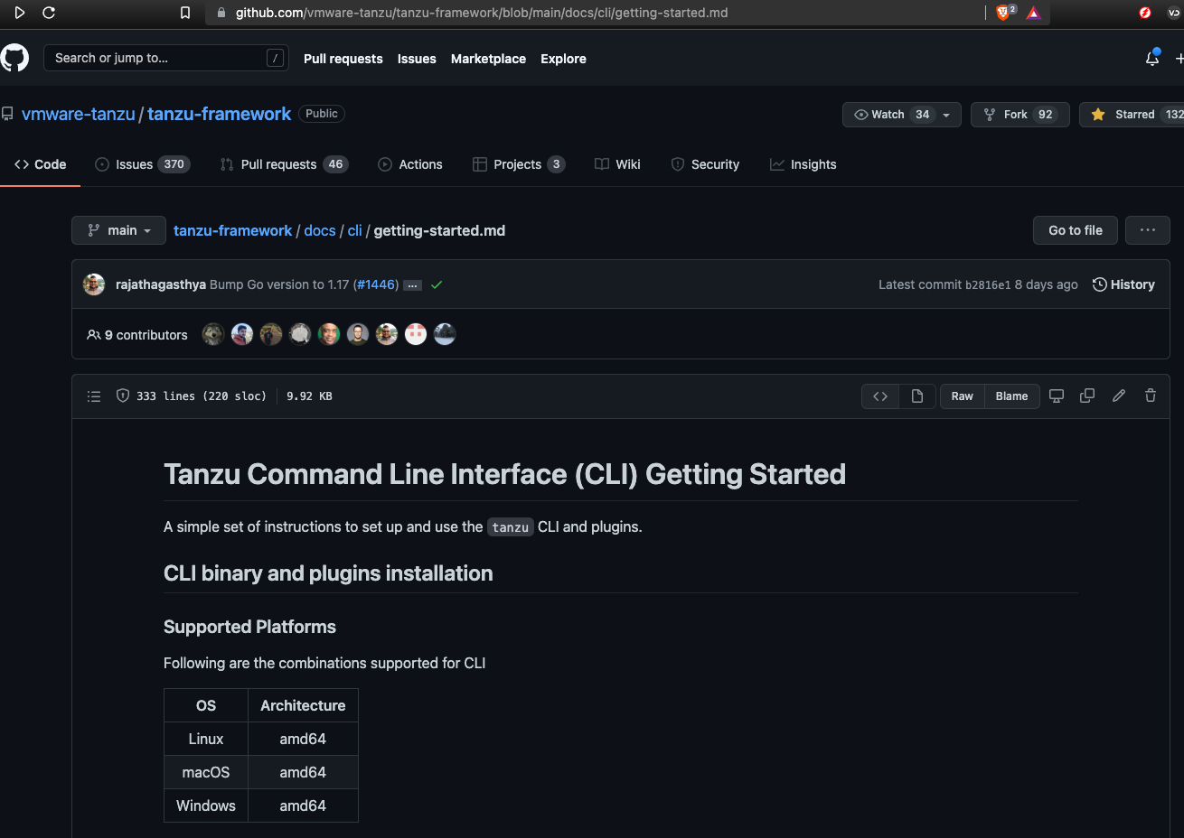
How TCE is used in our workshop
Tanzu CLI

Slide 8
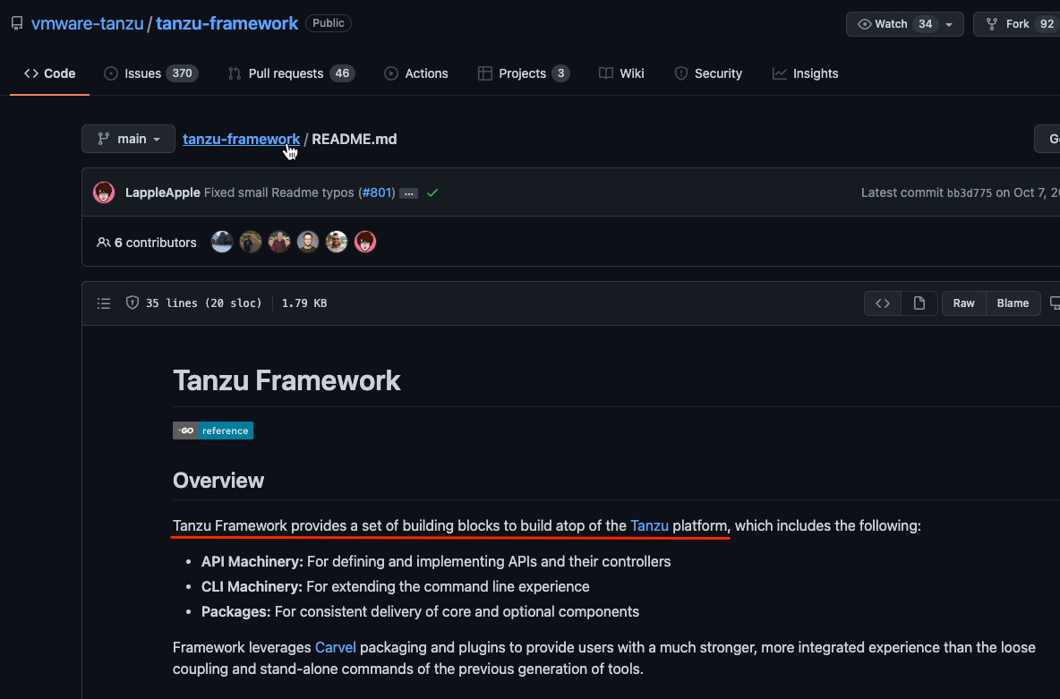
How TCE is used in our workshop
Tanzu CLI

Slide 9
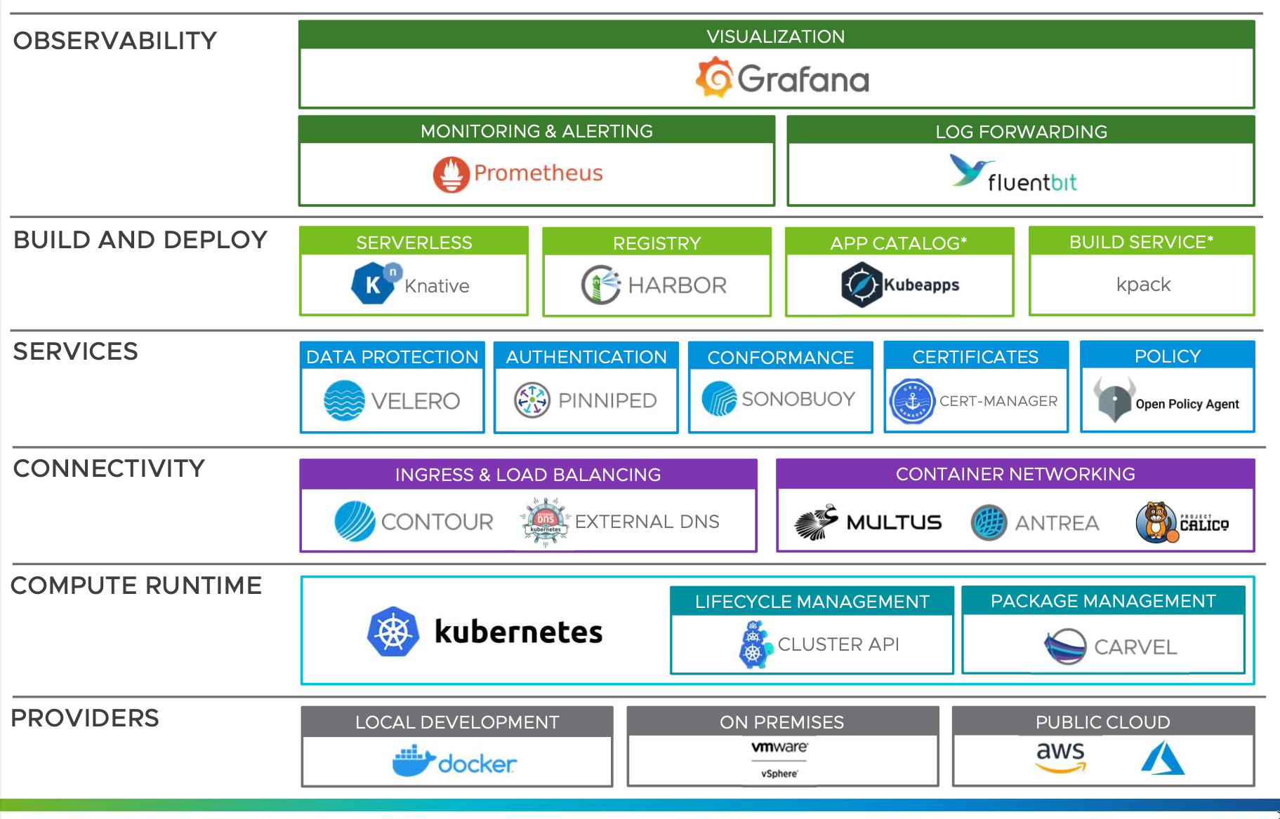
How TCE is used in our workshop

Slide 10
How does TCE do this?

Slide 11
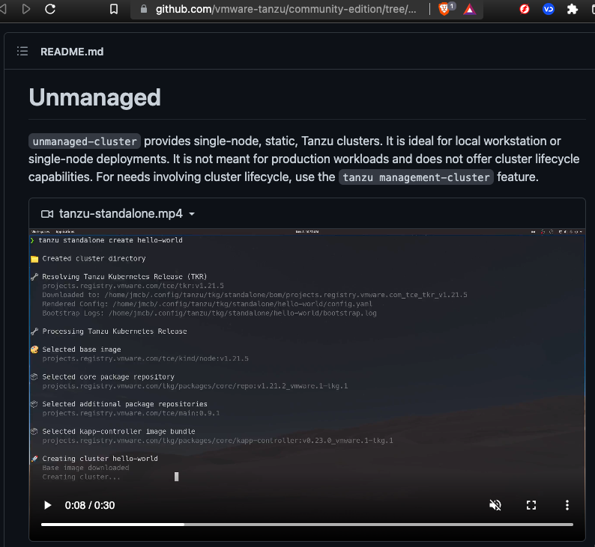
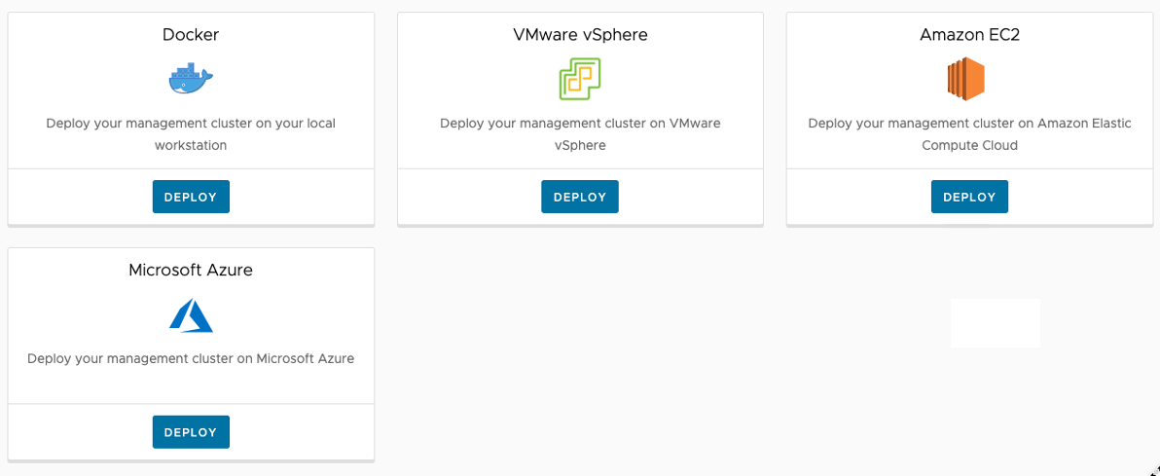
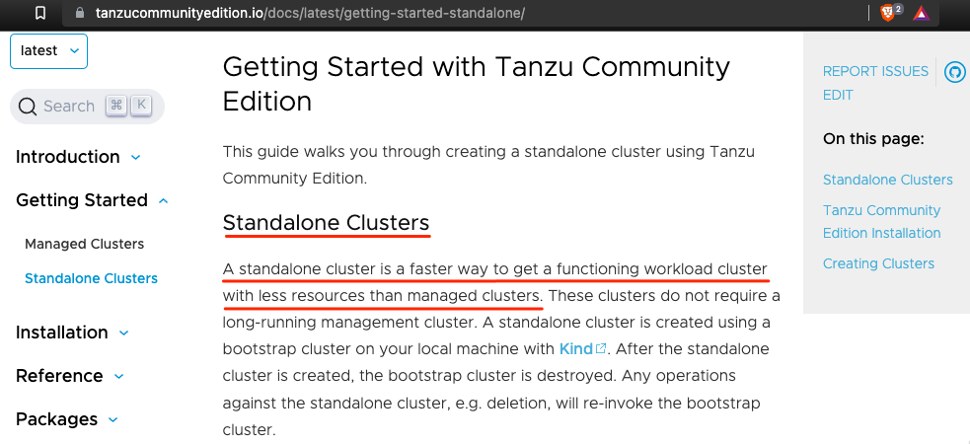
“standalone-cluster” → “unmanaged-cluster”
Ref: https://github.com/vmware-tanzu/community-edition/tree/main/cli/cmd/plugin/unmanaged-cluster#design-details
How does TCE do this?

Slide 12
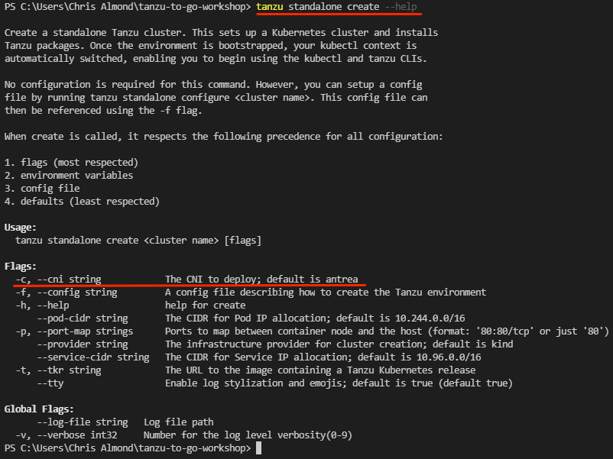
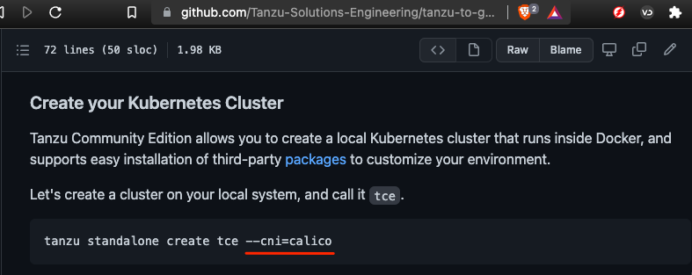
How does TCE do this?

Slide 13
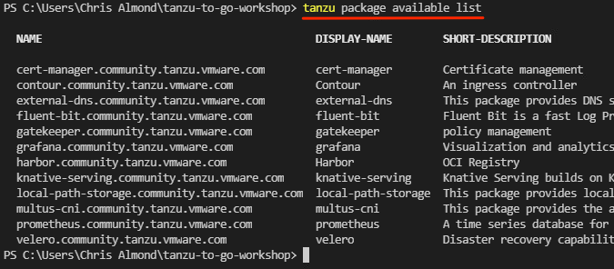
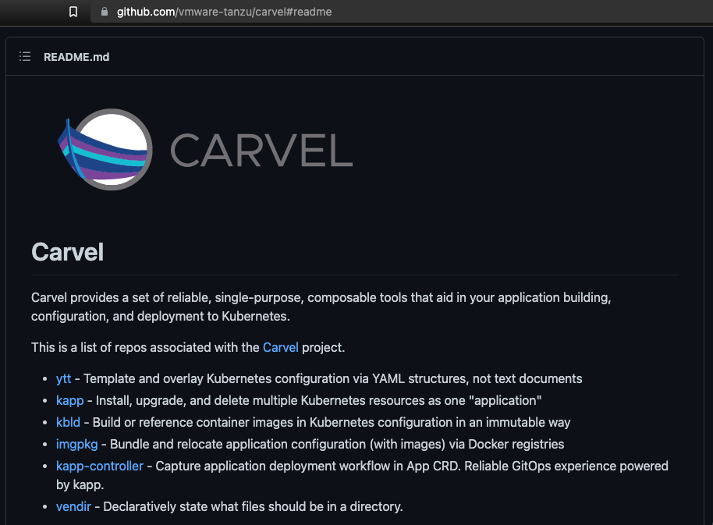

How does TCE do this?

Slide 14
Let’s get on with it!

Slide 15
Tanzu Community Edition - 201

